Slide 1

NFL 1st and Future - Helmet Impact Detection
Adrian Alexa 2160731
Adriano Semerano 2160754
Link to the competition
https://www.kaggle.com/competitions/nfl-impact-detection/overview
Academic year 2025/2026

Slide 2

Introduction
The National Football League (NFL) has teamed up with Amazon Web Services (AWS) to develop the “Digital Athlete,” a virtual representation of a composite NFL player that the NFL can use to model game scenarios to try to better predict and prevent player injury. The NFL is actively addressing the need for a computer vision system to detect on-field helmet impacts as part of the “Digital Athlete” platform, and the league is calling on Kagglers to help
The information provided is sourced from the NFL’s Next Gen Stats (NGS) system, which documents the position, speed, acceleration, and orientation for every player on the field during NFL games.

Slide 3
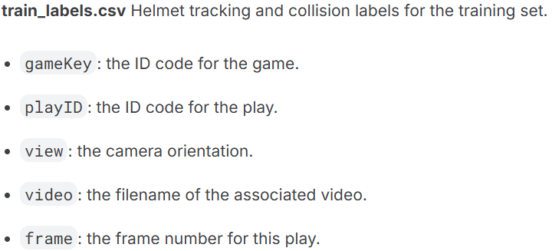
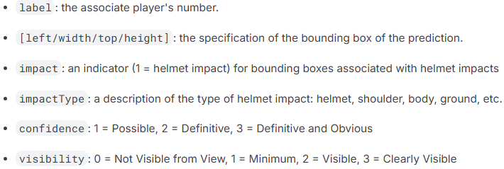
Dataset Description
Each play has two associated videos, showing a sideline and an endzone view, and the videos are aligned so that frames correspond between the videos. To aid with helmet detection, an ancillary dataset of images showing helmets with labeled bounding boxes has been provided.
The file containing the necessary data regarding helmet tracking and collision label for the training set is:
Train_labels.csv
Visual data reference of some of the many registered impacts

Slide 4
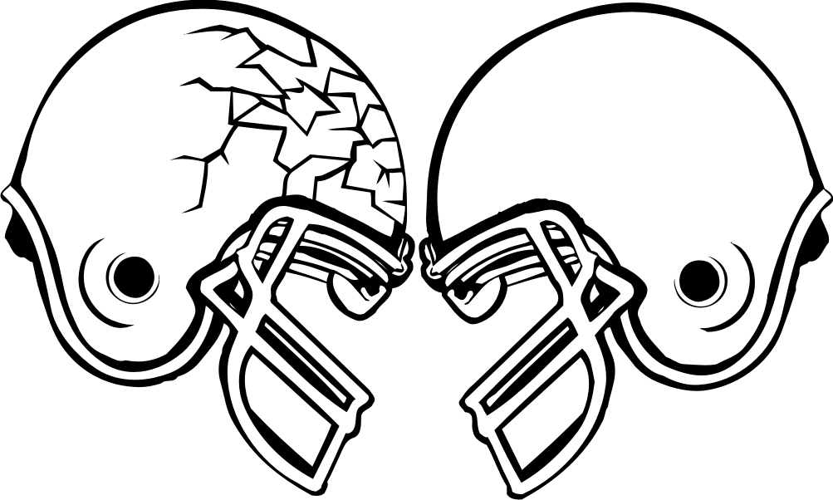
Dataset Description
Each play has two associated videos, showing a sideline and an endzone view, and the videos are aligned so that frames correspond between the videos. To aid with helmet detection, an ancillary dataset of images showing helmets with labeled bounding boxes has been provided.
The file containing the necessary data regarding helmet tracking and collision label for the training set is:
Train_labels.csv
Visual data reference of some of the many registered impacts
Definitive but not visible
Definitive and visible

Slide 5
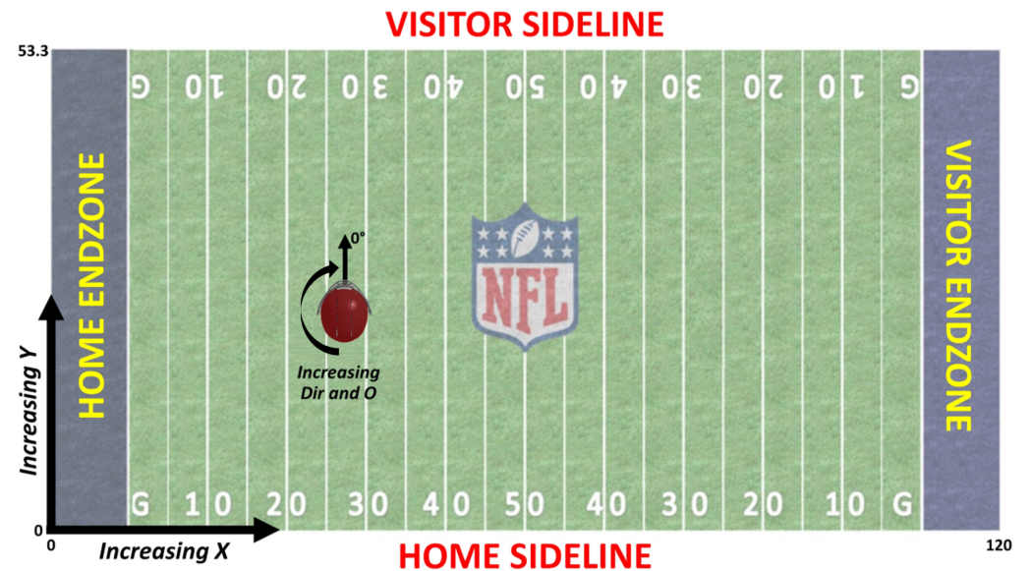
Dataset Description
The Sideline and Endzone views have been time-synced such that the snap occurs 10 frames into the video. Video data is recorded at approximately 59.94 frames per second)
Notes:
hose labels with confidence = 1 document cases in which human labelers asserted it was possible that a helmet impact occurred, but it was not clear that the helmet impact altered the trajectory of the helmet.
Those labels with visibility = 0 indicate that although there is reason to believe that an impact occurred to that helmet at that time, the impact itself was not visible from the view.

Slide 6
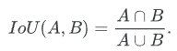
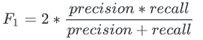
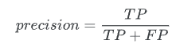
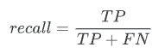
Metrics & Evaluation
The challenge`s guideline clearly states that although the objective is to precisely and correctly assess whether an impact involving helmets is happening at one or more points on the field and in the videos, there are still a few important differences when it comes using the player`s helmet bounding boxes:
The main departure from a traditional metric is that some imprecision on the timing of the impact is acceptable. For a given ground truth impact, a prediction within +/- 4 frames (9 frames total) within the same play can be accepted as valid without necessarily degrading the score. Assuming the player is moving over the course of those frames, the exact bounding box predicted to achieve an IoU of 1.0 would also vary depending on the frame.
As one helmet may partially obscure another from the camera's perspective, both predicted and ground truth bounding boxes may overlap. However, at most one prediction will ever be assigned to a given ground truth box.
The necessary metrics used to assess the grade of success of the model pipeline are the following
The IoU (Intersection of Units) of a proposed bounding box and a ground truth bounding needs to be at least 0.35 or higher in order to be considered a True Positive for all the metrics, leaving the other possibilities interchangeable.
Notes:
hose labels with confidence = 1 document cases in which human labelers asserted it was possible that a helmet impact occurred, but it was not clear that the helmet impact altered the trajectory of the helmet.
Those labels with visibility = 0 indicate that although there is reason to believe that an impact occurred to that helmet at that time, the impact itself was not visible from the view.

Slide 7
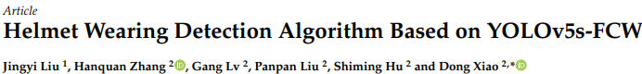
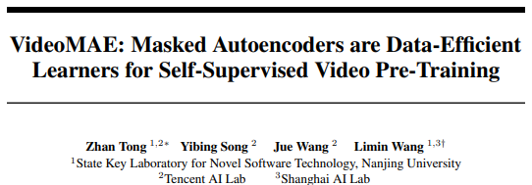
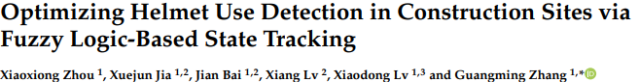
Baseline/Paper
Video impact analysis is an extremely complex computer vision problem, located at the intersection between object detection(OD), multi-object tracking (MOT), and spatio-temporal action recognition(STAR)
The dominant architecture for detecting impact through space and time is usually a multi-stage pipeline that stretches itself through different fields
Spatial detection and localization: YOLO (You only look once) family predominance, going from v5 up to v11
Temporal Tracing and Object association: DeepSort and StrongSort are the predominant methods for this task
Helmet Impact Classification: The CNN 2.5 approach was the leading one for this task during past years, however VisionTransformers (ViT) have been making concrete progress in the fields, thus steadily increasing their use and effectiveness over CNNs.
We also can find other architectures much more recent which rely Graph Neural Network (GCN), focusing more on the relation between players on the field and the nature of an impact, being a consequence of 2 or more players interacting.
To further enhance all the possible technologies we found as a core the use of NFL`s Sensor Fusion. It is a Next Generation Representation of what players look like on the fields, but in terms of data. As a matter of fact, during the last couple of years, a new initiative has been brought forward by the NFL to increase Feature engineering on new technologies of tracing through sensors, and Late Fusion to polish and detect impacts on the field.

Slide 8
Approaches & considerations
We tried different approaches:
Trained a pre-trained YOLO model using the players helmet coordinates for detection and tracking
Built custom BB player detector by combining
Pose predictions of a Detectron2 model trained on COCO
Players helmets bounding boxes from the csv

Slide 9
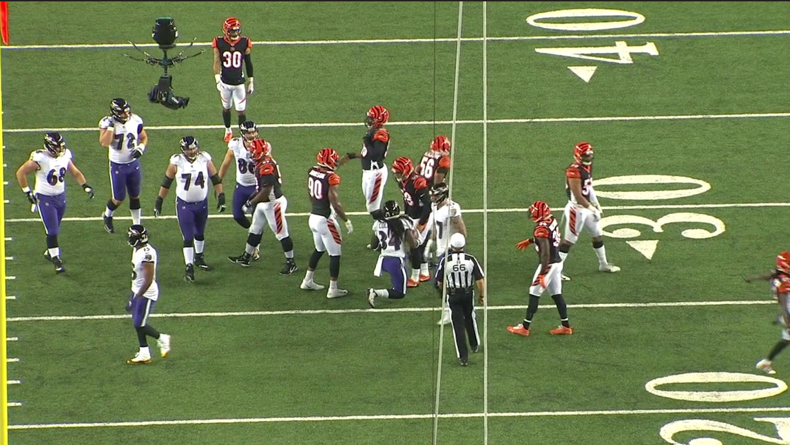
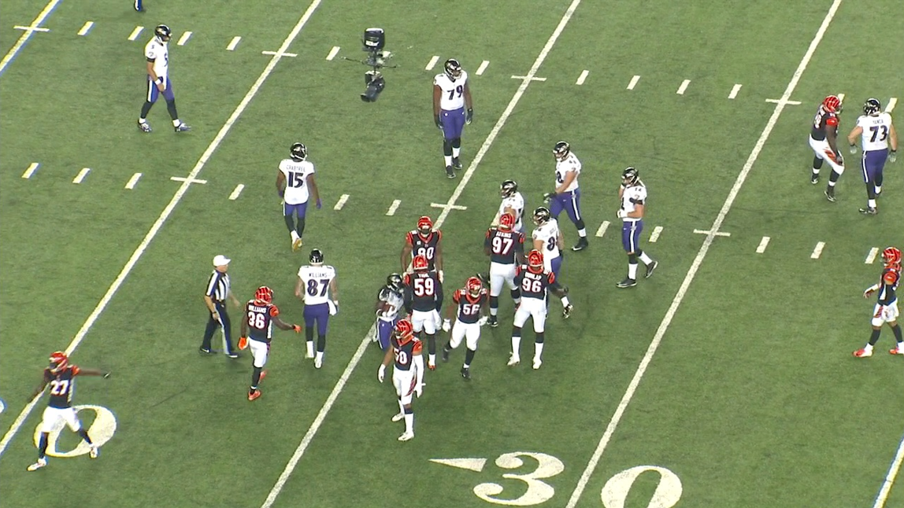
Samples- Frames
Raw Frame 399 from 57583_000082_Endzone game
Raw Frame 399 from 57583_000082_Sideline game

Slide 10
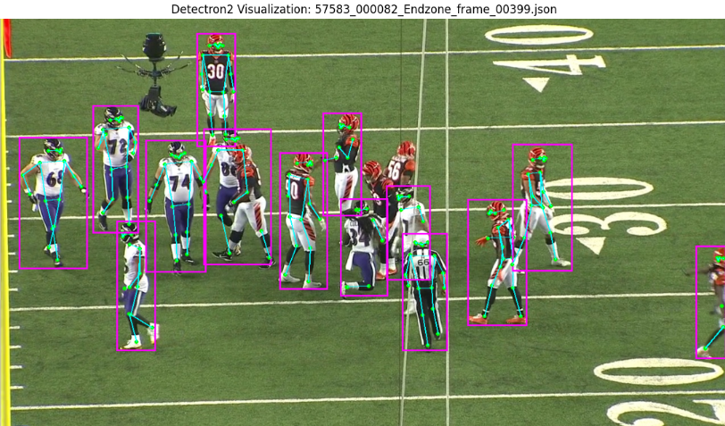
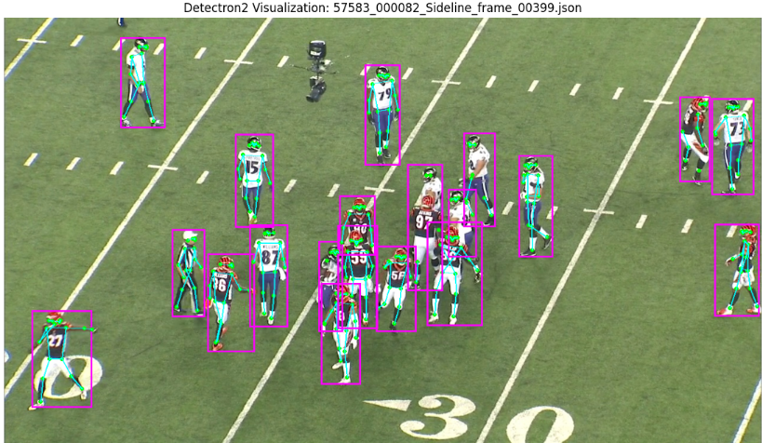
Samples- BB estimation
Annotated BB predictions Frame 399 from 57583_000082_Endzone
Annotated BB Frame 399 from 57583_000082_Sideline

Slide 11
Approaches & considerations
We tried different approaches:
Trained a pre-trained YOLO model using the players helmet coordinates for detection and tracking
Built custom BB player detector by combining
Pose predictions of a Detectron2 model trained on COCO
Players helmets bounding boxes from the csv
Used the predictions of player bounding boxes as input to a CNN for jersey number detection

Slide 12
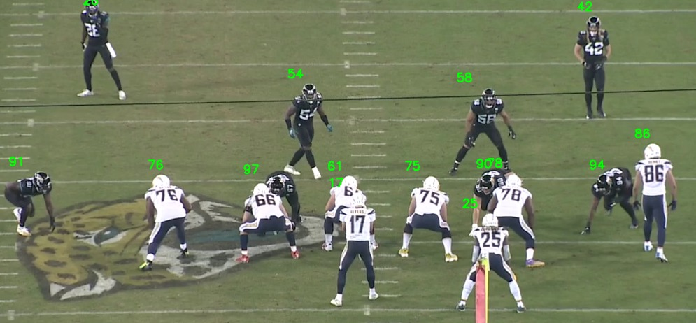
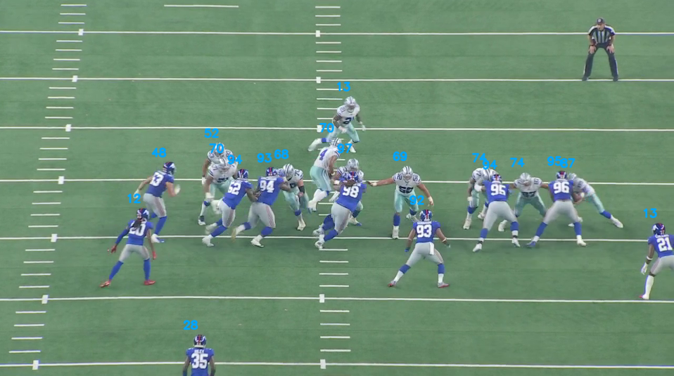
Samples- Jersey number detection
Training phase
Testing phase

Slide 13
Approaches & considerations
We tried different approaches:
Trained a pre-trained YOLO model using the players helmet coordinates for detection and tracking
Built custom BB player detector by combining
Pose predictions of a Detectron2 model trained on COCO
Players helmets bounding boxes from the csv
Used the predictions of player bounding boxes as input to a CNN for jersey number detection
Applied Canny filters and Cross-View to and field lines and match the 2 different camera views/angles
Estimated players feet field coordinates using the predictions of player bounding boxes to match the Sideline and Endzone distinctive field plans.
Packed all the models into an End-to-End pipeline
Notes:
As a result we were met with many limitations, the dataset itself was not matched to perfection and presented lots of hidden inconsistencies, the differences between predictions of the models used for the detection of players BB added too much noise, further spanned by the amount of player data and game videos.

Slide 14
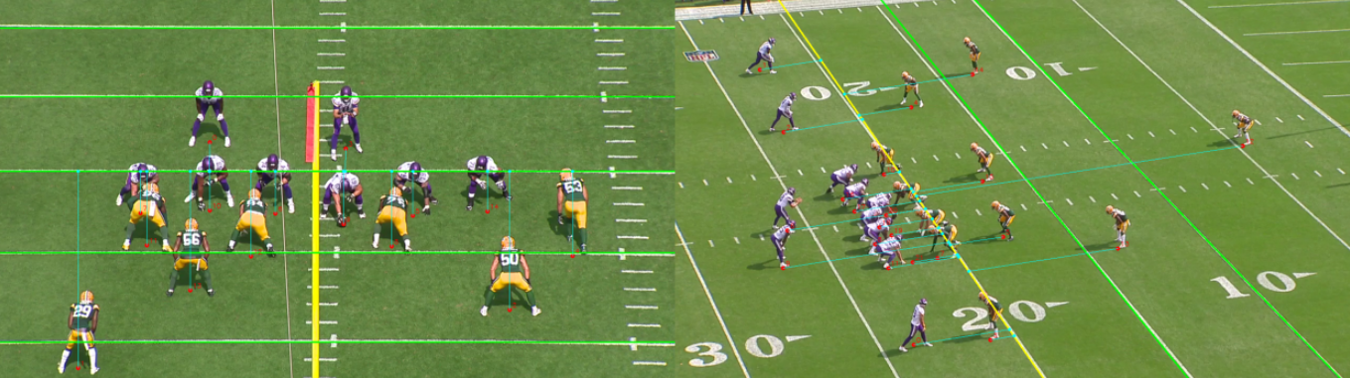
Samples- Field lines detection
Estimated Endzone Lines
Estimated Sideline lines

Slide 15
Approaches & considerations
At first we tried different approaches:
Trained a pre-trained YOLO model using the players helmet coordinates for detection and tracking
Built custom BB player detector by combining
Pose predictions of a Detectron2 model trained on COCO
Players helmets bounding boxes from the csv
Used the predictions of player bounding boxes as input to a CNN for jersey number detection
Applied Canny filters and Cross-View to and field lines and match the 2 different camera views/angles
Estimated players feet field coordinates using the predictions of player bounding boxes to match the Sideline and Endzone distinctive field plans.
Packed all the models into an End-to-End pipeline
Given the nature of our approach, having those specific stacked models wasn`t the correct strategy for the project to take off and work.

Slide 16

Approaches & considerations
At first we tried different approaches:
Trained a pre-trained YOLO model using the players helmet coordinates for detection and tracking
Built custom BB player detector by combining
Pose predictions of a Detectron2 model trained on COCO
Players helmets bounding boxes from the csv
Used the predictions of player bounding boxes as input to a CNN for jersey number detection
Applied Canny filters and Cross-View to and field lines and match the 2 different camera views/angles
Estimated players feet field coordinates using the predictions of player bounding boxes to match the Sideline and Endzone distinctive field plans.
Packed all the models into an End-to-End pipeline
Given the nature of our approach, having those specific stacked models wasn`t the correct strategy for the project to take off and work.
…..Wait
What does a helmet impact involve?
Can we learn something for the way players move across the field?

Slide 17
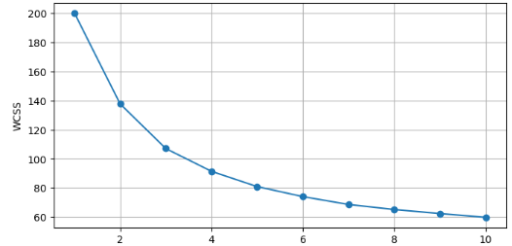
Data analysis
The dataset had lots of imbalanced data and was heavily confusionary, here are some of the relevant detriments found from our study:
the number of helmet impacts covered about %0.1579 of the total number of rows, being 1554 to 491942
the rows were not sorted out with respect to any criteria other than the game it was registered from
The detected helmet impact rows had a corresponding 1 frame duration against the high rate of fps
The players`s bounding boxes had an imbalanced resolution ratio with respect to the videos
Sideline and Endzone videos had different grade of usefulness and applicability in spatial/temporal matching
Some detected impacts had a 0 valued IoU, indicating absence of calculated overlap
To maximize our chances of success we applied some very needed preprocessing on the data
Clean, visualized and polished the provided dataset
Applied temporal stretching in order to capture the tracklets of helmets
Sorted out helmet impact rows and analyzed their tendencies in space
Elbow Method for clustering purposes
Temporal analysis with dilated bounding boxes using different dilation factor values, ranging from 1.0(A)-1.5(B)-2.0(C)-3.0(D)
WCSS
Number of clusters K

Slide 18
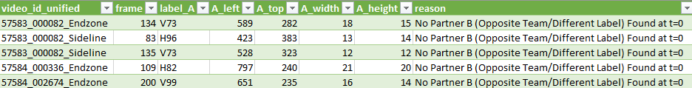
Data analysis
The dataset was heavily imbalanced and confusionary, here are some of the relevant detriments found from our study:
The number of registered helmet impacts covered about %0.1579 of the total number of rows, being 1554 to 491942
The dataset was missing out on the premise of having an assured partner to partner match

Slide 19
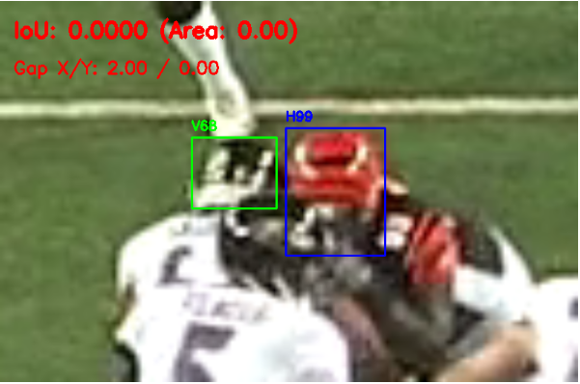
Data analysis
The dataset was heavily imbalanced and confusionary, here are some of the relevant detriments found from our study:
The number of registered helmet impacts covered about %0.1579 of the total number of rows, being 1554 to 491942
The dataset was missing out on the premise of having an assured partner to partner match
Some registered impacts had a 0 valued IoU, indicating absence of calculated overlap
To increase our chances of success we applied some very needed preprocessing on the data
Cleaned and polished the provided dataset
Applied temporal stretching in order to capture the tracklets of helmets
Sorted out helmet impact rows and analyzed their tendencies in space and frame-time
Elbow Method for clustering purposes
Temporal analysis with dilated bounding boxes using different dilation factor values, ranging from 1.0(A)-1.5(B)-2.0(C)-3.0(D)
Notes:
registered helmet impact rows did not necessarily have a correct frame correspondence from Endzone to Sideline and vice versa ,
57583_000082_Endzone.mp4 | Frame: 38 | Players : H99 vs V68

Slide 20
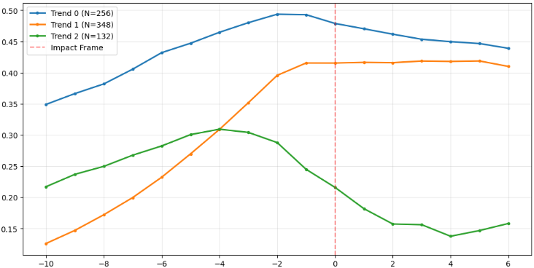
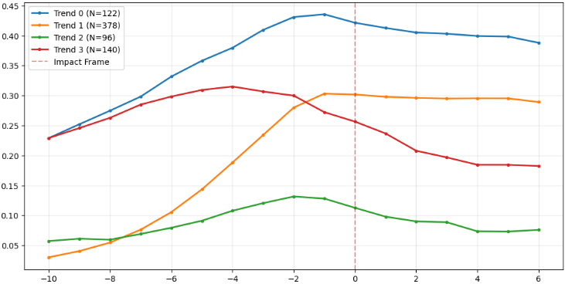
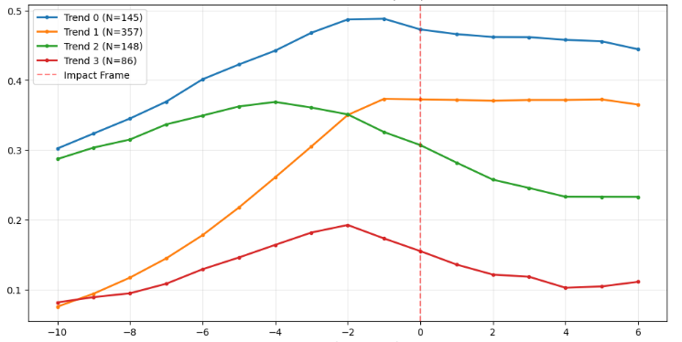
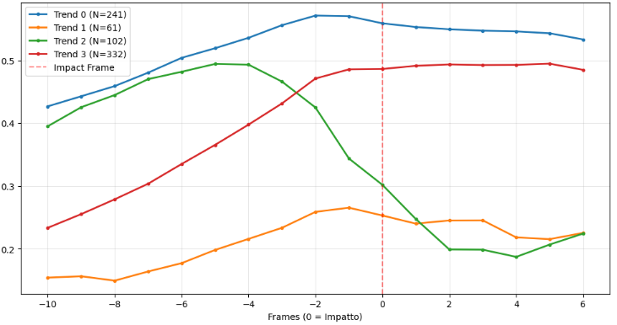
Data analysis
Tendency C
Tendency A
Average IoU
Average IoU
Frame(0=impact)
Tendency B
Frame(0=impact)
Tendency D
Average IoU
Average IoU
Frame(0=impact)
Frame(0=impact)

Slide 21
Changes
The objective remained the same but the way to work on it changed:
Make use of the helmets data and detection model Maintain
Use the overall pose of the players and their feet coordinates Discard
Tracking the jersey number Discard
Using Cross View Discard
Detecting field lines to match players given 2 videos of the same game Discard
Learn useful features from the player's movement across the field and obtain their embeddings Implement
Use the learnt embeddings as tracklets of movements per fixed frame spans Implement
Use the context of a helmet as additional information for the impact detection Implement
Utilize a R(2+1) CNN on helmets coordinates and player movement embeddings for helmet impact detection Implement
Notes:
We provide a baseline algorithm that first decodes neural activity into phoneme probabilities and then uses an n-gram language model plus LLM rescoring to decode the phoneme probabilities into text
the activity from the cortical recordings was used to predict the most likely English phoneme being attempted. Phoneme sequences were then combined into words with the use of an openly available language model
They trained two neural decoders with identical architectures but slightly different training parameters. The outputs were passed through the regular 5-gram and LLM decoding step leading to two predicted sentences for a given neural activity. They then used another LLM that evaluated the scores of these two sentences, and selected the sentence with the higher score.

Slide 22


Changes
The objective remained the same but the way to work on it changed:
Make use of the helmets data and detection model Maintain
Use the overall pose of the players and their feet coordinates Discard
Tracking the jersey number Discard
Using Cross View Discard
Detecting field lines to match players given 2 videos of the same game Discard
Learn useful features from the player's movement across the field and obtain their embeddings Implement
Use the learnt embeddings as tracklets of movements per fixed frame spans Implement
Use the context of a helmet as additional information for the impact detection Implement
Utilize a R(2+1) CNN on helmets coordinates and player movement embeddings for helmet impact detection Implement
Notes:
We provide a baseline algorithm that first decodes neural activity into phoneme probabilities and then uses an n-gram language model plus LLM rescoring to decode the phoneme probabilities into text
the activity from the cortical recordings was used to predict the most likely English phoneme being attempted. Phoneme sequences were then combined into words with the use of an openly available language model
They trained two neural decoders with identical architectures but slightly different training parameters. The outputs were passed through the regular 5-gram and LLM decoding step leading to two predicted sentences for a given neural activity. They then used another LLM that evaluated the scores of these two sentences, and selected the sentence with the higher score.

Slide 23
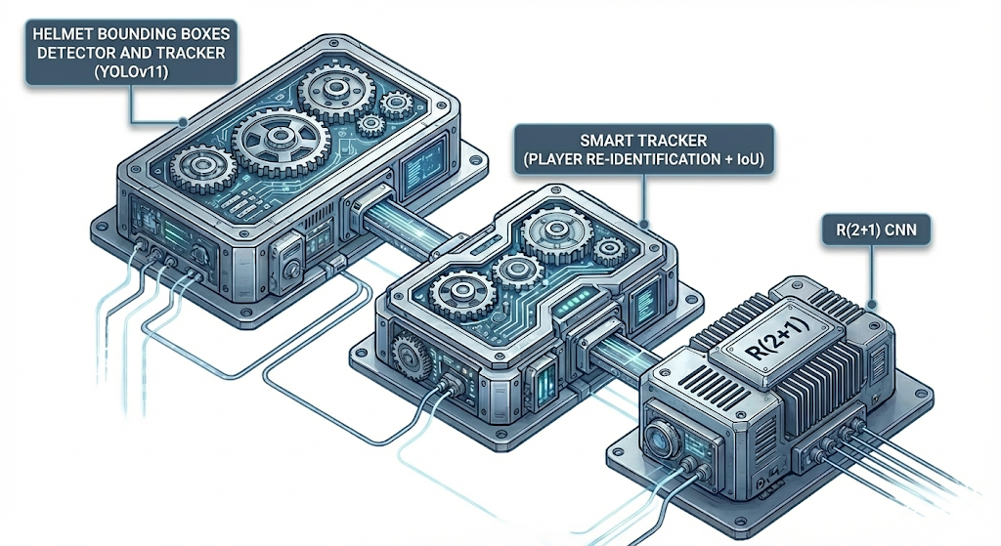
Implementation- End-to-End Impact Detection Pipeline
Notes:
We provide a baseline algorithm that first decodes neural activity into phoneme probabilities and then uses an n-gram language model plus LLM rescoring to decode the phoneme probabilities into text
the activity from the cortical recordings was used to predict the most likely English phoneme being attempted. Phoneme sequences were then combined into words with the use of an openly available language model
They trained two neural decoders with identical architectures but slightly different training parameters. The outputs were passed through the regular 5-gram and LLM decoding step leading to two predicted sentences for a given neural activity. They then used another LLM that evaluated the scores of these two sentences, and selected the sentence with the higher score.

Slide 24
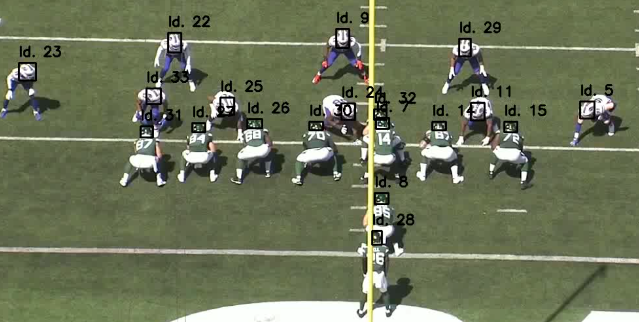
YOLOv11 Training
1. Data Preparation & Normalization
This phase transforms videos into compatible training assets.
Selective Extraction: We sparse-sample frames (e.g., 100 frames/video) rather than using the full video sequence.
Coordinate Translation: We normalized the coordinates (Center-Relative, 0-1 scale).
2. Dataset Structuring
Randomized Shuffling: Extracted frames are shuffled to break any time-dependency bias
The 80/15/5 Split for Training,Validation and Testing.
3. Transfer Learning with YOLOv11
Load weights pre-trained on the COCO dataset.
We freeze the early layers and strictly retrain the final layers to recognize the specific visual signature of a "Football Helmet."
The Blueprint (YAML): A configuration file that maps the dataset paths and defines the single class ID 0: Helmet
Notes:
This prevents overfitting to specific temporal movements and ensures visual diversity.
(which recognize basic edges/shapes)

Slide 25
Smart Tracker
1. Visual Identity Encoding
The Model: A ResNet-18 CNN modified to act as a Feature Extractor.
The Process: It analyzes the visual texture, color, and patterns of the helmet.
The Output (Embedding): A 128-dimensional vector, it`s the player's "digital fingerprint." Even if the player moves across the screen, this vector remains mathematically similar, allowing us to recognize them.
2. The Foundation: Hybrid State & Weighted Costs
Identity = Physics + Appearance
Unlike standard trackers, we model a player's identity using two competing signals managed by a Weighted Cost Matrix.
The Physics (W_{IOU}= 0.70): We track position (BB). This is the dominant signal when a player is clearly visible to ensure smooth trajectories.
The Appearance (W_{ReID}= 0.30): We track visual identity using a Rolling Buffer of the last 30 embeddings. Instead of comparing against a single blurry frame, we compare against the statistical Mean Embedding, creating a robust "Visual Center of Gravity."
Notes:
We provide a baseline algorithm that first decodes neural activity into phoneme probabilities and then uses an n-gram language model plus LLM rescoring to decode the phoneme probabilities into text
the activity from the cortical recordings was used to predict the most likely English phoneme being attempted. Phoneme sequences were then combined into words with the use of an openly available language model
They trained two neural decoders with identical architectures but slightly different training parameters. The outputs were passed through the regular 5-gram and LLM decoding step leading to two predicted sentences for a given neural activity. They then used another LLM that evaluated the scores of these two sentences, and selected the sentence with the higher score.

Slide 26
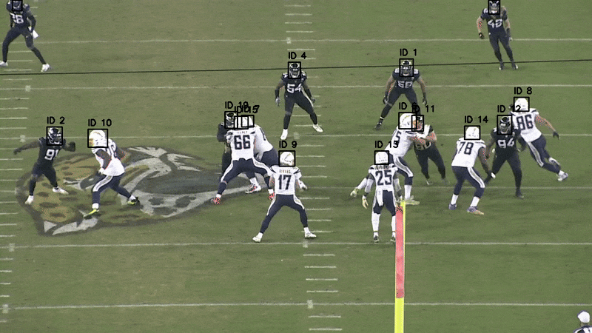
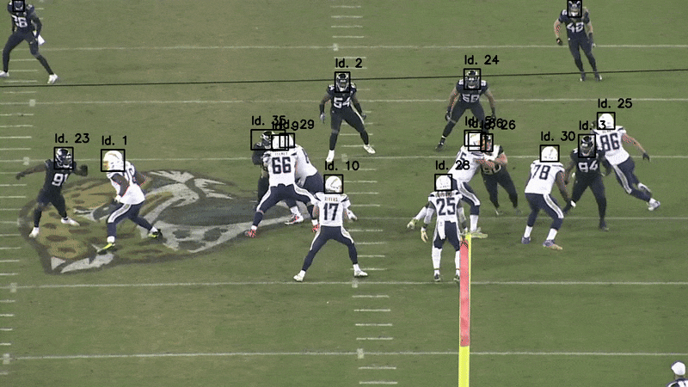
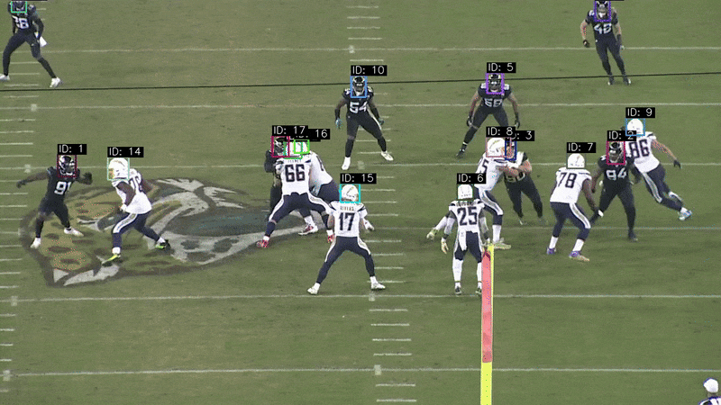
Results- Smart Tracker
DeepSORT
ByteTrack
Custom
Notes:
We provide a baseline algorithm that first decodes neural activity into phoneme probabilities and then uses an n-gram language model plus LLM rescoring to decode the phoneme probabilities into text
the activity from the cortical recordings was used to predict the most likely English phoneme being attempted. Phoneme sequences were then combined into words with the use of an openly available language model
They trained two neural decoders with identical architectures but slightly different training parameters. The outputs were passed through the regular 5-gram and LLM decoding step leading to two predicted sentences for a given neural activity. They then used another LLM that evaluated the scores of these two sentences, and selected the sentence with the higher score.

Slide 27
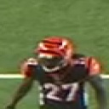
Smart Tracker
3. The Core Logic: Two-Stage Association
Handling Visibility vs. Occlusion
Stage 1: Active Tracking (High Precision):
For visible players, we enforce a strict IoU Veto. Even if the visual match is perfect, if the boxes don't overlap, the match is rejected. This prevents IDs from "teleporting" across the field.
Stage 2: Lost Recovery (High Recall):
When a track is lost (occluded), it enters a "Memory State."
The system scans unmatched detections using Visual Similarity Only (ignoring position). If a new detection strongly matches a lost track's Mean Embedding (>0.60% similarity), the old ID is "snapped" onto the new object, automatically stitching the broken track.
4. Lifecycle & Output Generation
Data Hygiene
Memory Window: "Lost" tracks are kept alive for 60 frames (~1 second). If not visually re-acquired by then, they are permanently deleted.
Noise Filtration: Any track shorter than 15 frames is discarded as noise (e.g., referees, ball).
Dual-Crop Export: The surviving tracks generate the training data:
Tight Crop (64px): Saved to maintain the ID.
Context Crop (128px): Saved to feed the Impact Detection model (capturing the collision environment).
Notes:
We provide a baseline algorithm that first decodes neural activity into phoneme probabilities and then uses an n-gram language model plus LLM rescoring to decode the phoneme probabilities into text
the activity from the cortical recordings was used to predict the most likely English phoneme being attempted. Phoneme sequences were then combined into words with the use of an openly available language model
They trained two neural decoders with identical architectures but slightly different training parameters. The outputs were passed through the regular 5-gram and LLM decoding step leading to two predicted sentences for a given neural activity. They then used another LLM that evaluated the scores of these two sentences, and selected the sentence with the higher score.

Slide 28
R(2+1) CNN
1. The Architecture: Factorized Convolutions
Standard 3D CNNs use massive cubic kernels (3 x 3 x 3) to learn space and time simultaneously, which is computationally heavy and hard to optimize. The R(2+1)D-18 model solves this via Factorization.
Spatial Phase (2D): The model first applies spatial convolutions (3 x 3 x 1) to understand the shape of the helmet and players.
Temporal Phase (1D): It immediately follows with temporal convolutions (1 x 1 x 3) to understand the movement (velocity/acceleration) across frames.
Non-Linearity: Crucially, a nonlinear activation (ReLU) is inserted between these two steps, doubling the network's ability to learn complex motion patterns compared to a standard 3D CNN.
2. The Input Volume & Custom Head
Context-Aware Learning
The Input: A 4D Tensor (16 frames x 3 channels x 64 x 64). This represents a ~0.3-second "video volume" centered on the tracked player using the Context Crops.
The Custom Head: We replace the standard classification layer with a robust, domain-specific head:
High Dropout (0.5): Randomly disables 50% of neurons during training. This forces the model to look at motion dynamics rather than memorizing static details like specific jersey numbers.
Frame-wise Logits: The model outputs a probability score for every frame in the sequence, allowing precise temporal localization of the hit.
Notes:
An impact is defined by the interaction between a player and their environment.

Slide 29
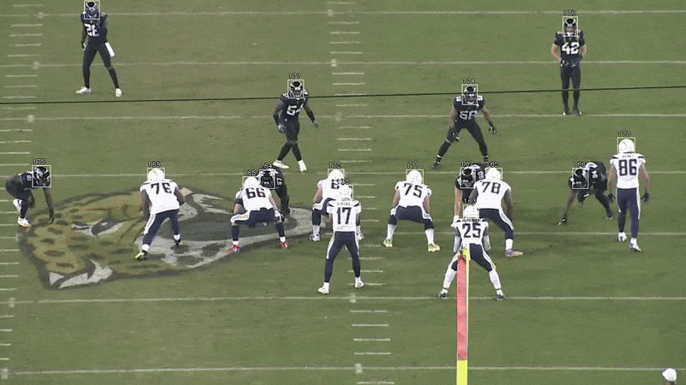
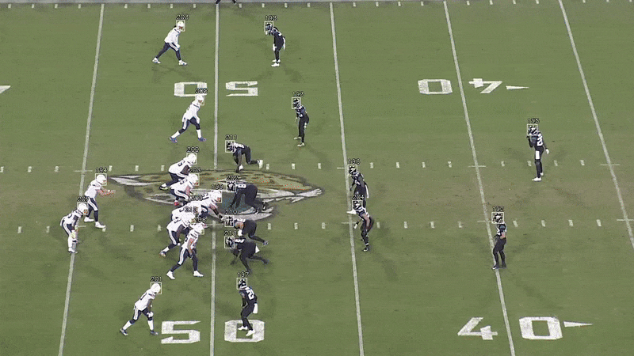
R(2+1) CNN
3. Inference Strategy: Sliding Window Aggregation
Stabilizing Predictions via Voting
Since a tackle is a continuous event, analyzing a single isolated clip is unreliable. The code implements a Soft Majority Voting system.
Sliding Window: The 16-frame window slides across the video track with a stride of 4 frames.
Overlap: This means every single video frame is analyzed by the neural network 4 distinct times (as the start, middle, and end of different windows).
Consensus: The final "Impact Score" for a frame is the average of these 4 predictions. This filters out noise; a true impact will trigger high probabilities in all overlapping windows, whereas a camera glitch will only trigger one.
Notes:
We provide a baseline algorithm that first decodes neural activity into phoneme probabilities and then uses an n-gram language model plus LLM rescoring to decode the phoneme probabilities into text
the activity from the cortical recordings was used to predict the most likely English phoneme being attempted. Phoneme sequences were then combined into words with the use of an openly available language model
They trained two neural decoders with identical architectures but slightly different training parameters. The outputs were passed through the regular 5-gram and LLM decoding step leading to two predicted sentences for a given neural activity. They then used another LLM that evaluated the scores of these two sentences, and selected the sentence with the higher score.

Slide 30
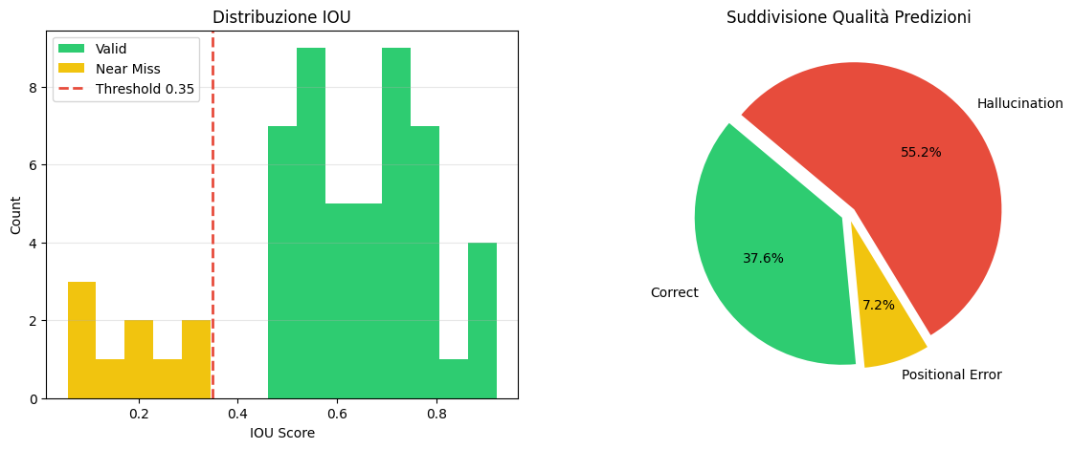
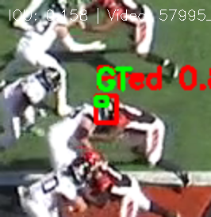
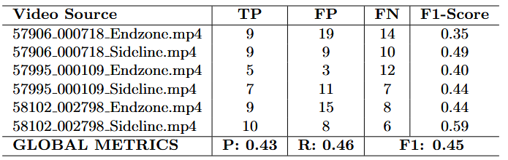
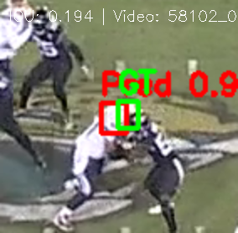
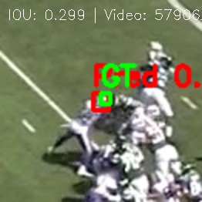
Final Results
Notes:
We provide a baseline algorithm that first decodes neural activity into phoneme probabilities and then uses an n-gram language model plus LLM rescoring to decode the phoneme probabilities into text
the activity from the cortical recordings was used to predict the most likely English phoneme being attempted. Phoneme sequences were then combined into words with the use of an openly available language model
They trained two neural decoders with identical architectures but slightly different training parameters. The outputs were passed through the regular 5-gram and LLM decoding step leading to two predicted sentences for a given neural activity. They then used another LLM that evaluated the scores of these two sentences, and selected the sentence with the higher score.

Slide 31
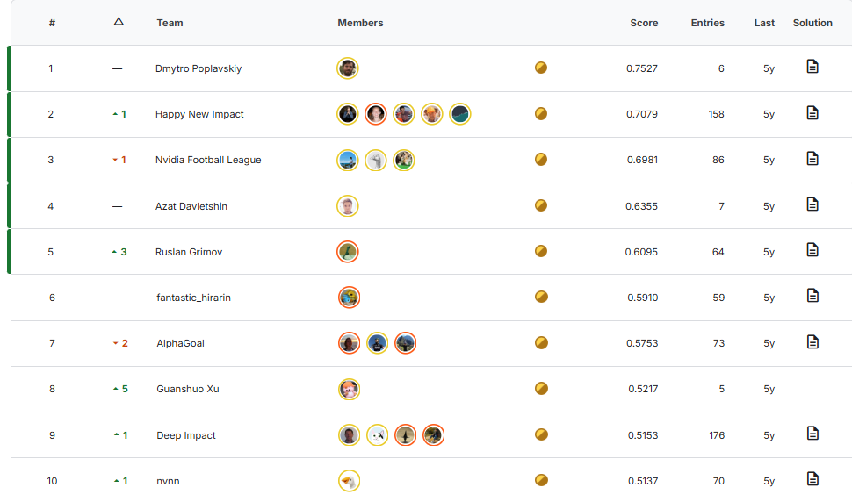
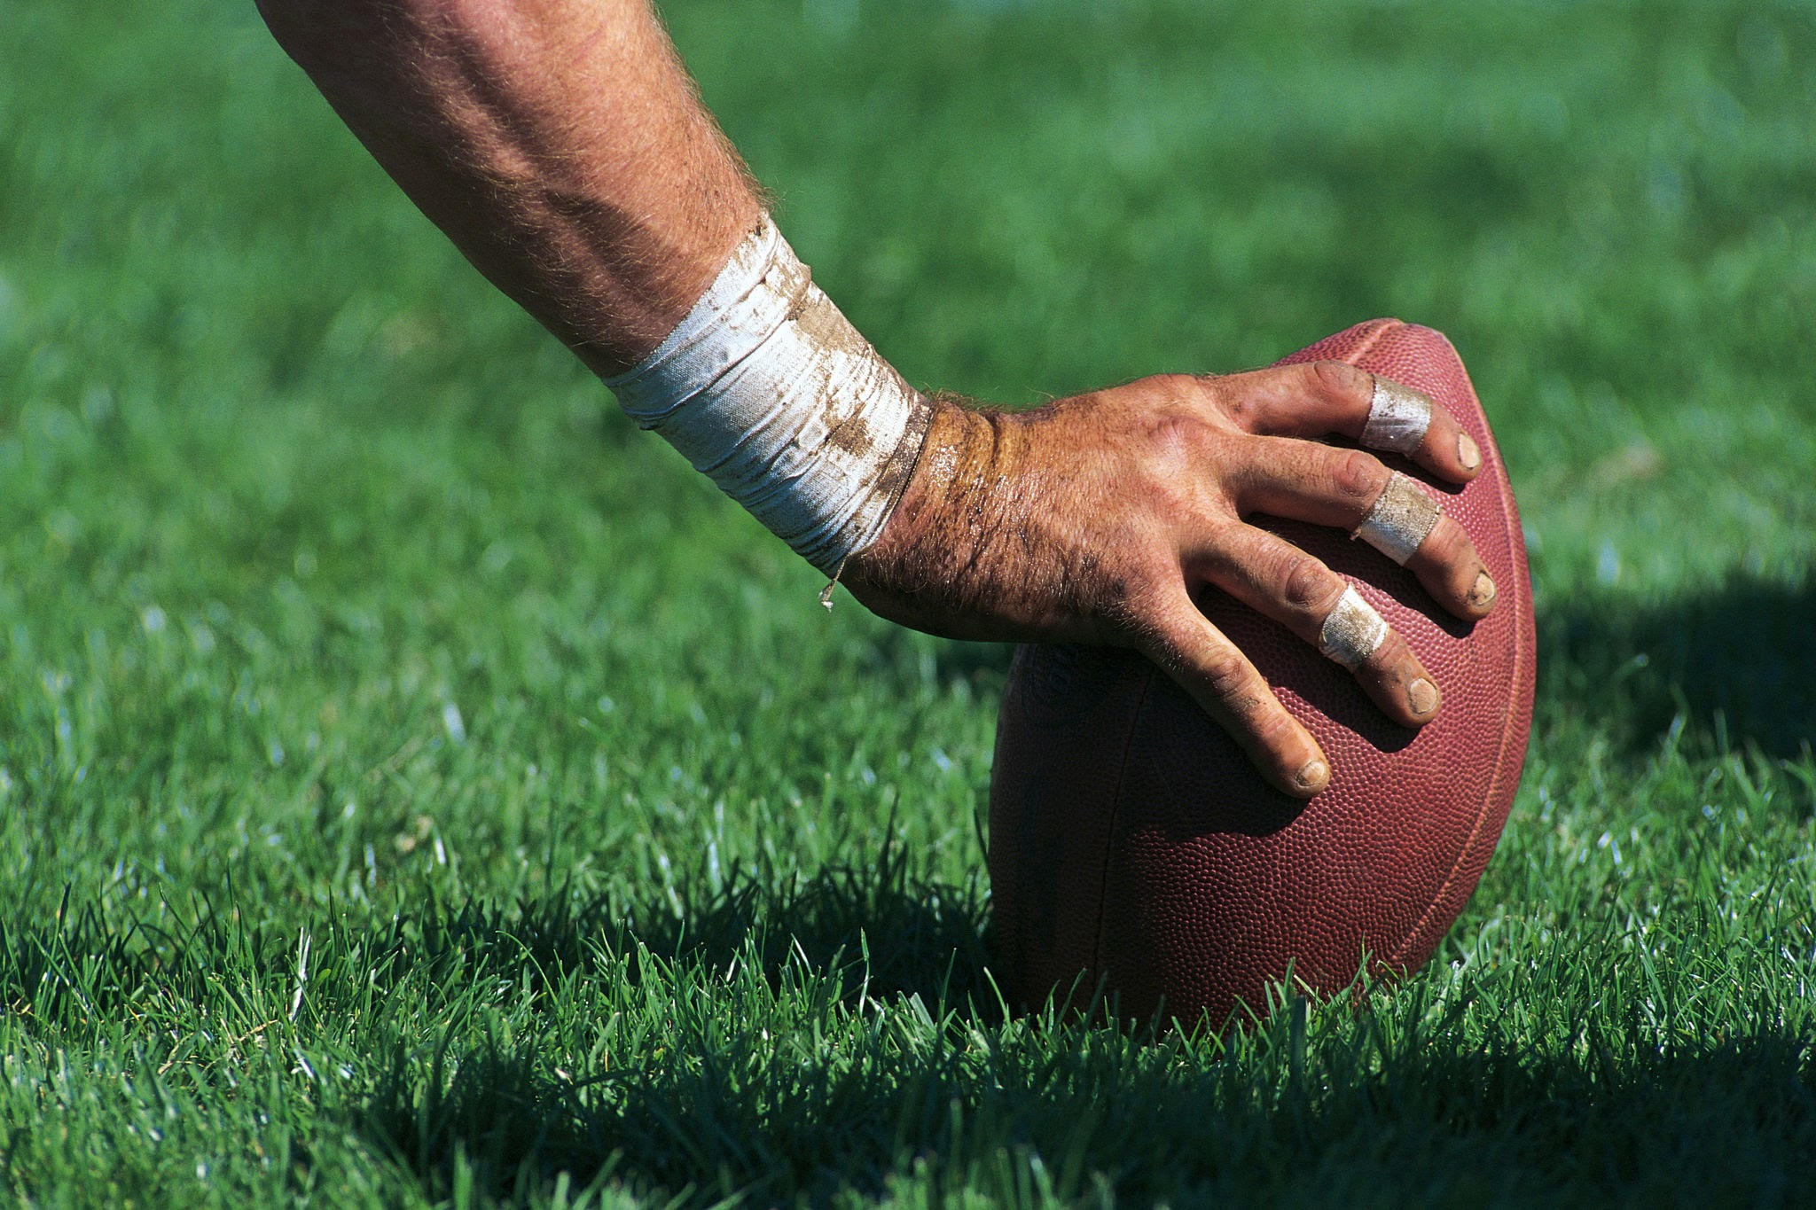
Conclusion
We didn't aim for flashiness; we aimed for function and stability. The complexity of this NFL challenge forced us to assess the problem much deeper than originally planned. While we haven't solved for every variable yet—that requires more computational power and time—we have defined an architecture that puts us in a competitive position, should the challenge open again in the future.
Notes:
We provide a baseline algorithm that first decodes neural activity into phoneme probabilities and then uses an n-gram language model plus LLM rescoring to decode the phoneme probabilities into text
the activity from the cortical recordings was used to predict the most likely English phoneme being attempted. Phoneme sequences were then combined into words with the use of an openly available language model
They trained two neural decoders with identical architectures but slightly different training parameters. The outputs were passed through the regular 5-gram and LLM decoding step leading to two predicted sentences for a given neural activity. They then used another LLM that evaluated the scores of these two sentences, and selected the sentence with the higher score.

Slide 32
References
https://medium.com/@kdk199604/videomae-scaling-self-supervised-video-transformers-beyond-labeled-data-1048a780522d
https://www.mdpi.com/2076-3417/14/21/9741
https://pmc.ncbi.nlm.nih.gov/articles/PMC12568081/
Notes:
We provide a baseline algorithm that first decodes neural activity into phoneme probabilities and then uses an n-gram language model plus LLM rescoring to decode the phoneme probabilities into text
the activity from the cortical recordings was used to predict the most likely English phoneme being attempted. Phoneme sequences were then combined into words with the use of an openly available language model
They trained two neural decoders with identical architectures but slightly different training parameters. The outputs were passed through the regular 5-gram and LLM decoding step leading to two predicted sentences for a given neural activity. They then used another LLM that evaluated the scores of these two sentences, and selected the sentence with the higher score.

Slide 33

Thank you for the attention!

